Slide 1

Intelligent Robotics: Integrating AI and Perception on Raspberry Pi
Maira Tanweer Chachar, Muhammad Umer
Mr. Sitaram Ayyagari
Fall 2025, Robot Operating Systems, ITAI 2374.

Slide 2
Project Overview: Building an Autonomous PiCar-X
Components of PiCar-X
Hardware Components
Software Stack
Raspberry Pi 5 (main processor)
OpenCV (computer vision)
Camera Module (for vision/gesture recognition)
MediaPipe (hand gesture detection)
DC Motors with PWM control (movement)
ChatGPT API (natural language processing)
Ultrasonic Sensors (obstacle detection)
Python (primary language)
Servo Motors (steering/arm control)
ROS (Robot Operating System)
Power Management (battery, voltage regulators)
TensorFlow/PyTorch (ML models)
Communication modules (WiFi/Bluetooth)
Custom control algorithms

Slide 3
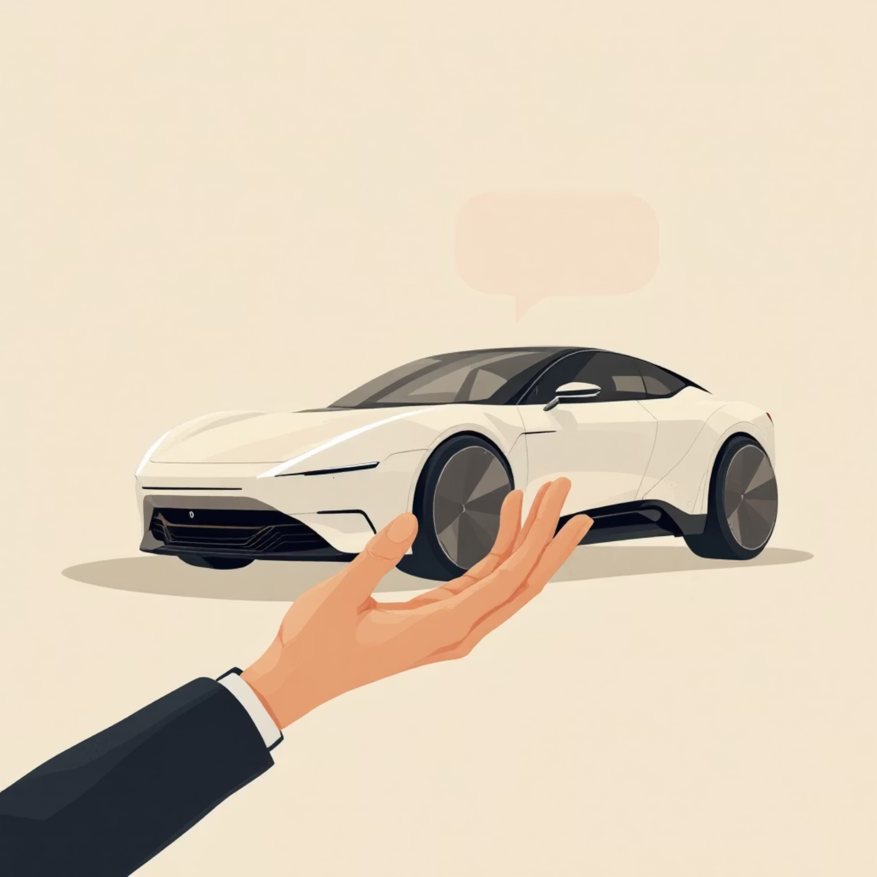
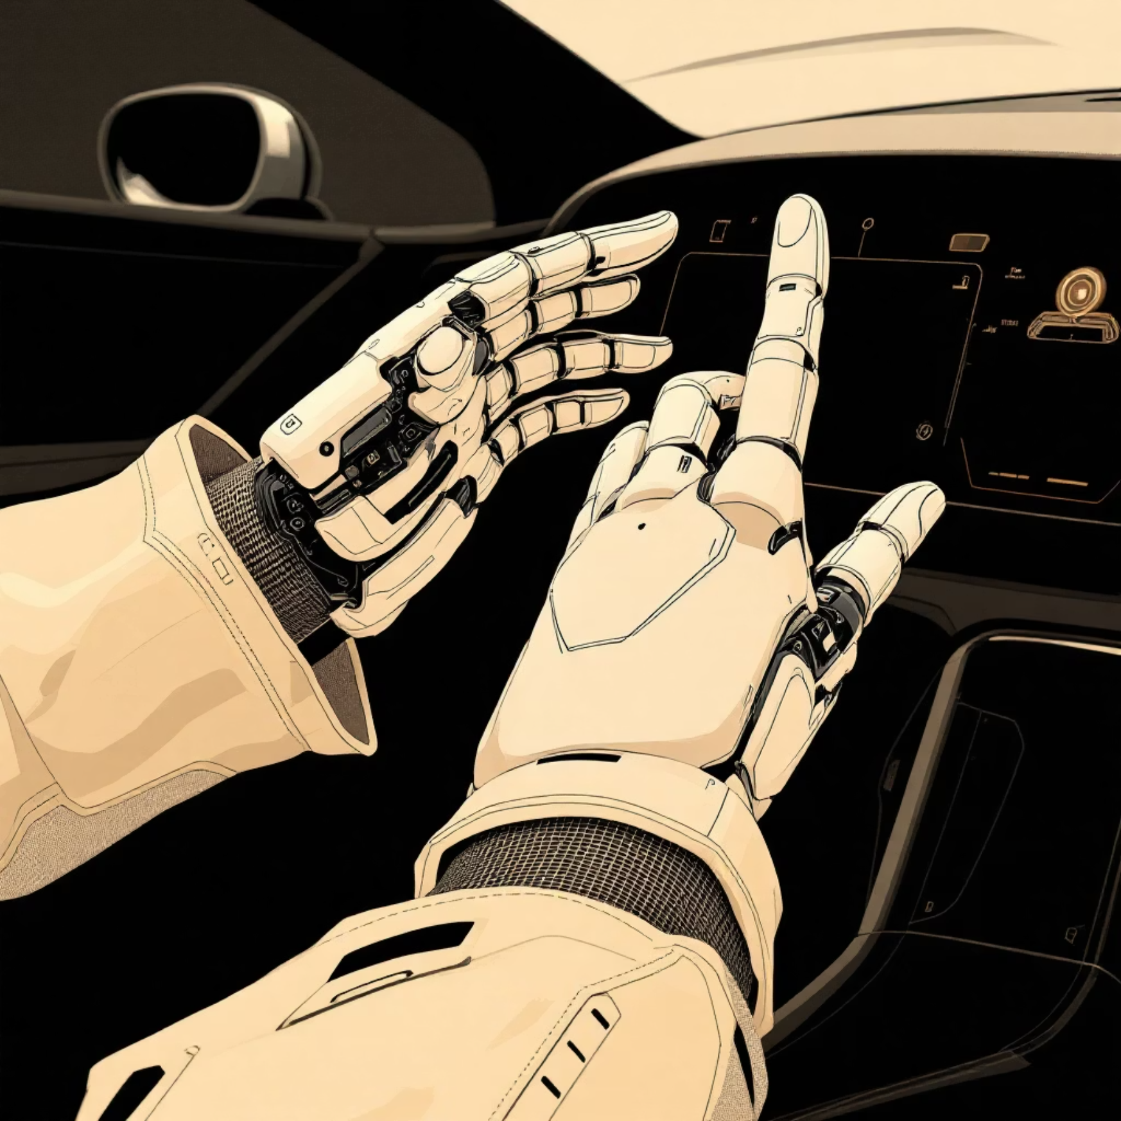
Enhanced Capabilities: AI and Gesture Control
ChatGPT Integration
Hand Gesture Control
Enabling natural language understanding and interaction for more complex commands and dynamic responses.
Allowing for a more direct and intuitive human-robot interface,
leveraging real-time visual perception.

Slide 4

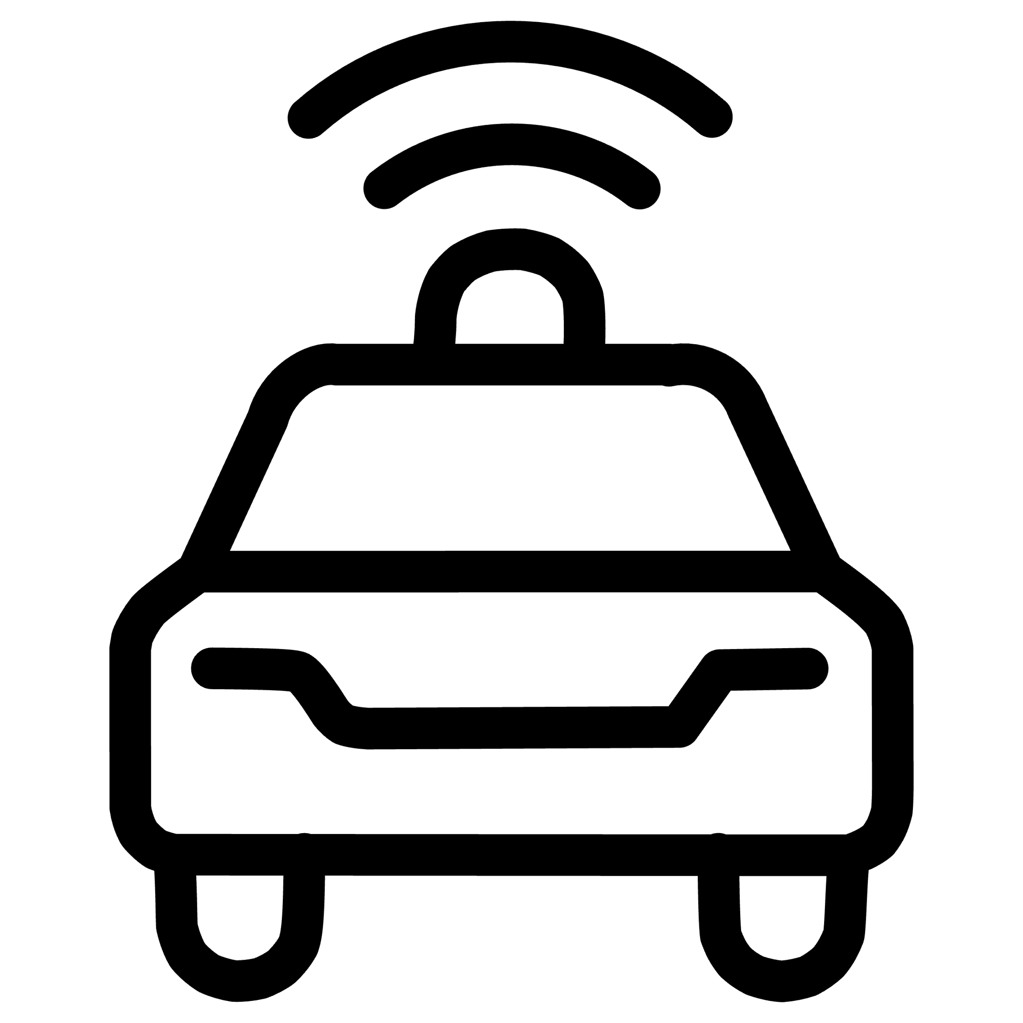


Our Core Goal: Functional Robotic Application
Our primary objective is to design and implement a functional robotic application that showcases key robotic principles through practical demonstration.
Sensor & Actuator Integration
Hand Gesture Driven Navigation
Seamlessly connecting inputs and outputs for dynamic interaction.
Enabling independent movement and pathfinding in varied environments.
Real-time Perception & Decision
Making
Safe & Ethical Operation
Processing sensory data to make informed
choices instantly.
Ensuring reliable and responsible robotic behavior in all scenarios.

Slide 5

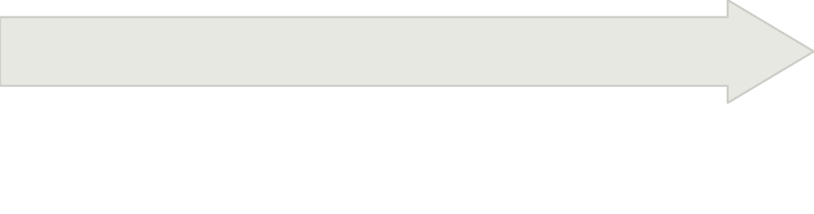
The Robotic Development Process: Ideation to Implementation
Our project follows a structured development pipeline, starting from initial concepts and moving through practical execution.
Implementation
Design
Gesture pipeline: camera → OpenCV → gesture classification → motor commands
Ideation
Hardware: PiCar-X chassis, camera, ultrasonic sensor, motors, SunFounder kit components
Intuitive robot control without physical controllers
Software: OpenCV (gesture detection), Mediapipe (hand landmarks), ROS 2 for modular control, ChatGPT for natural language mode
ChatGPT integration: natural language commands

Slide 6
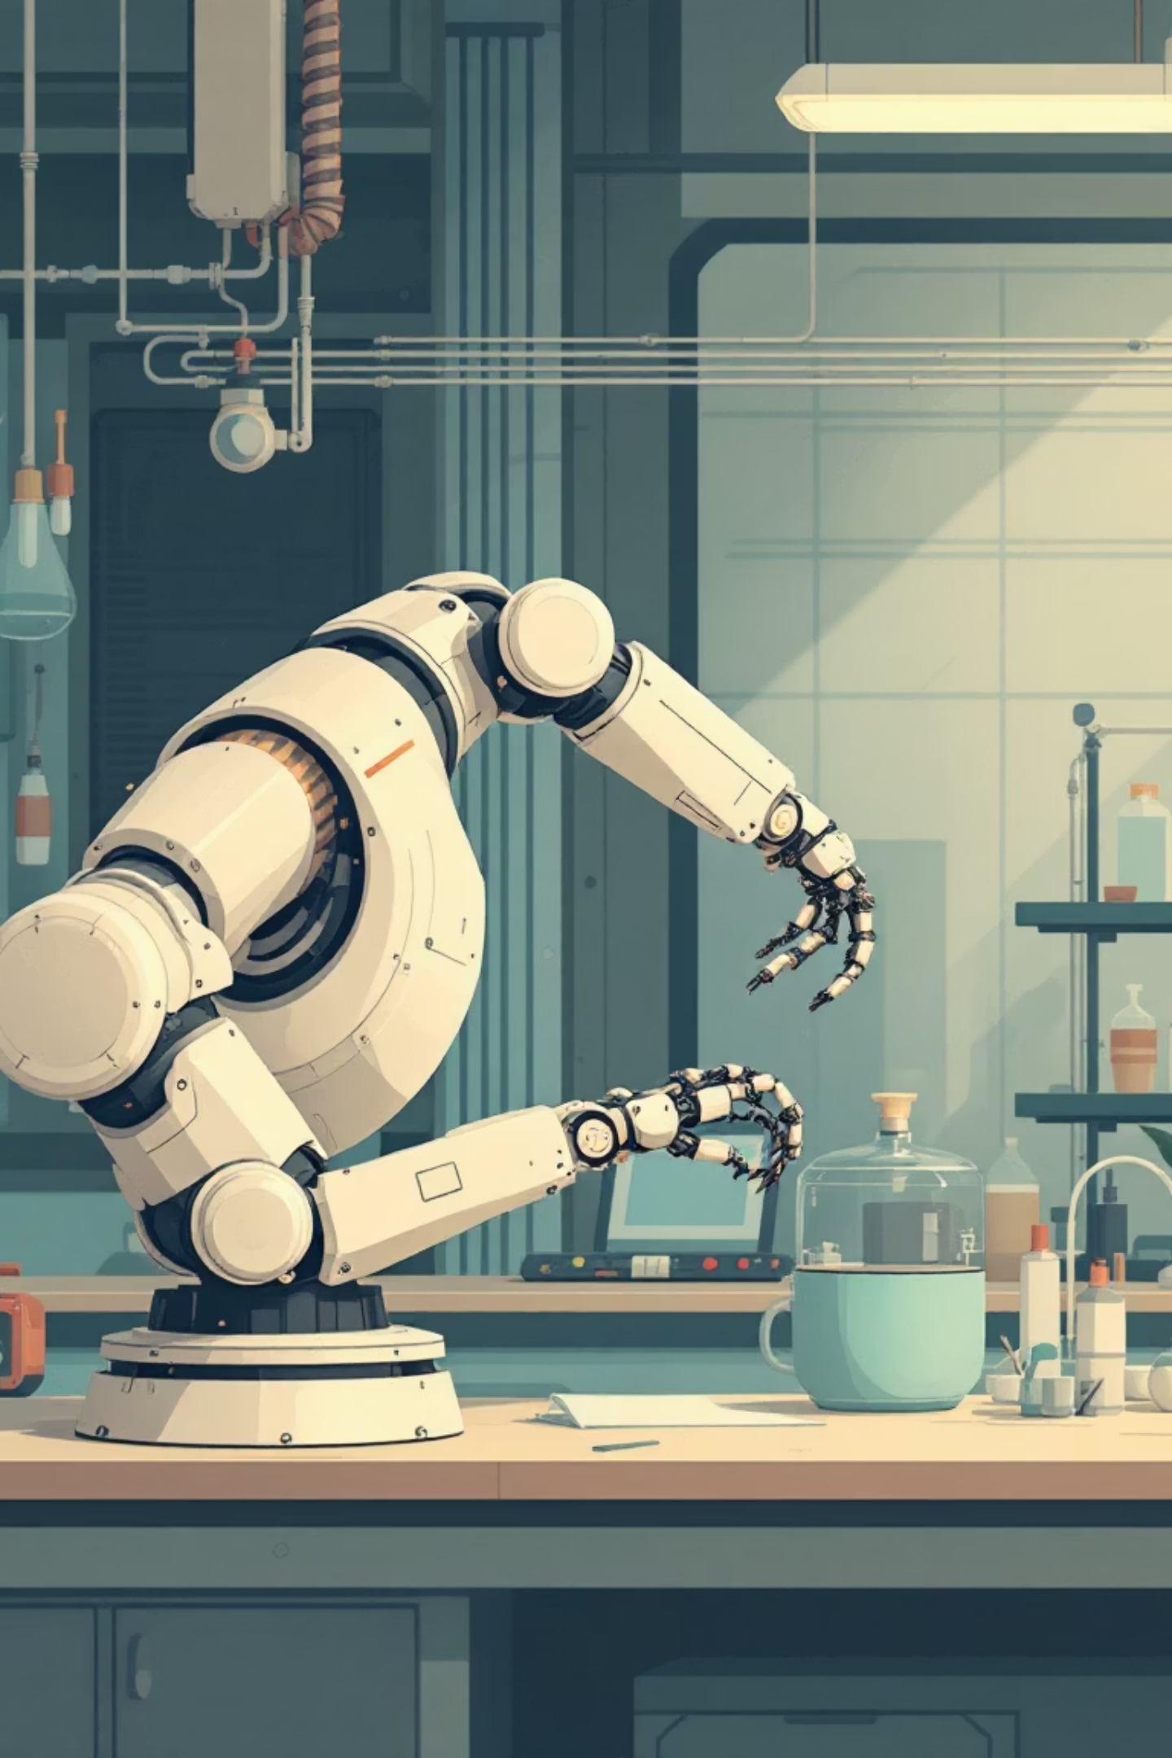
Critical Development Phases: Testing and Integration
Rigorous testing and thoughtful integration are paramount to building a reliable and unified robotic system.
1
Testing
Validating each individual module incrementally to ensure core functionality and address potential issues early.
2
Integration
Combining all developed modules into a cohesive, unified system, verifying inter-module communication and overall behavior.

Slide 7
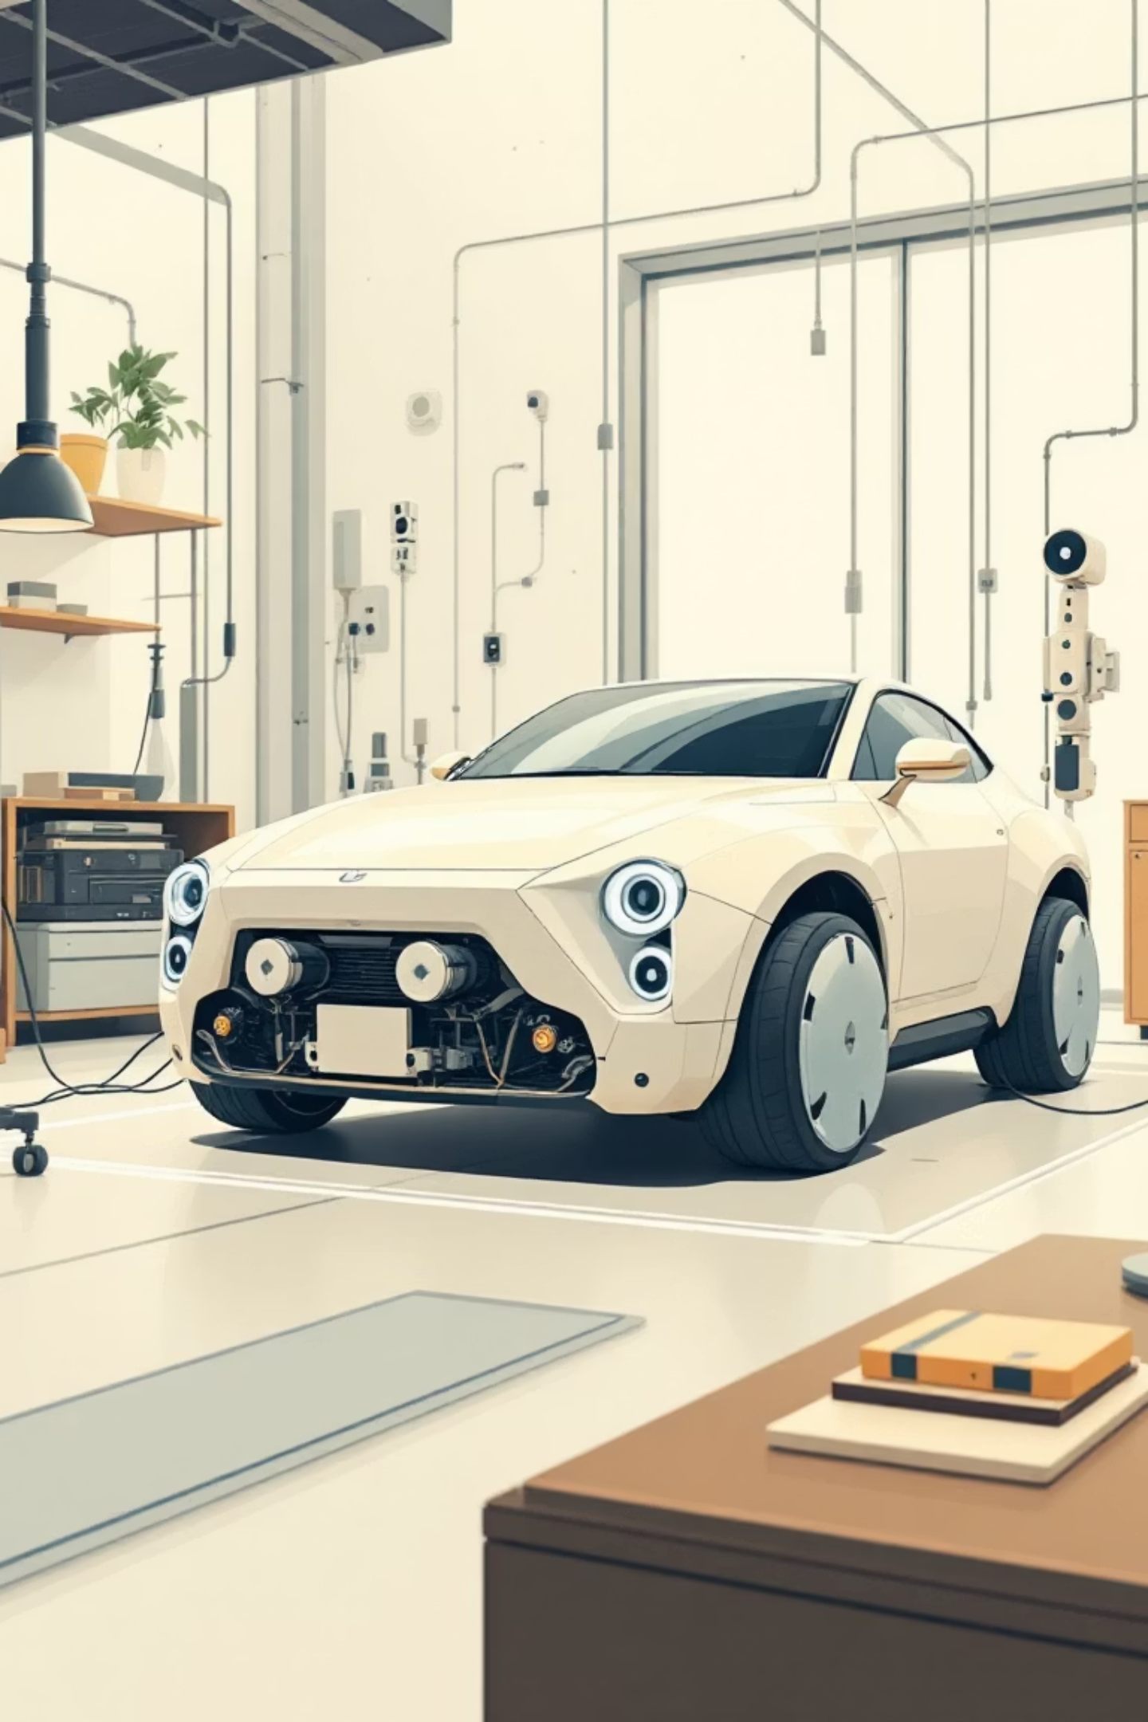
Testing & Integration: Validation and System Unification
Unit Testing
System Integration
Gesture detection accuracy validation
Unified gesture recognition pipeline
Motor response
Motor control synchronization
Sensor calibration verification
ChatGPT interface integration
Real-time data flow verification
Performance Metrics
Gesture recognition accuracy: >95%
Response latency: <200ms
Motor control stability: consistent trajectory
System uptime: reliable operation

Slide 8

System Architecture: Data Flow and Component Integration
Camera Input
OpenCV Gesture Recognition
Motor Driver
This simplified pipeline illustrates the core gesture recognition data flow. The camera captures hand gestures in real-time, which are then processed by OpenCV to classify specific movements. A ROS 2 node orchestrates the control logic, translating recognized gestures into commands that the motor driver executes for robot movement. The entire pipeline operates with <200ms latency, ensuring responsive and precise control.

Slide 9
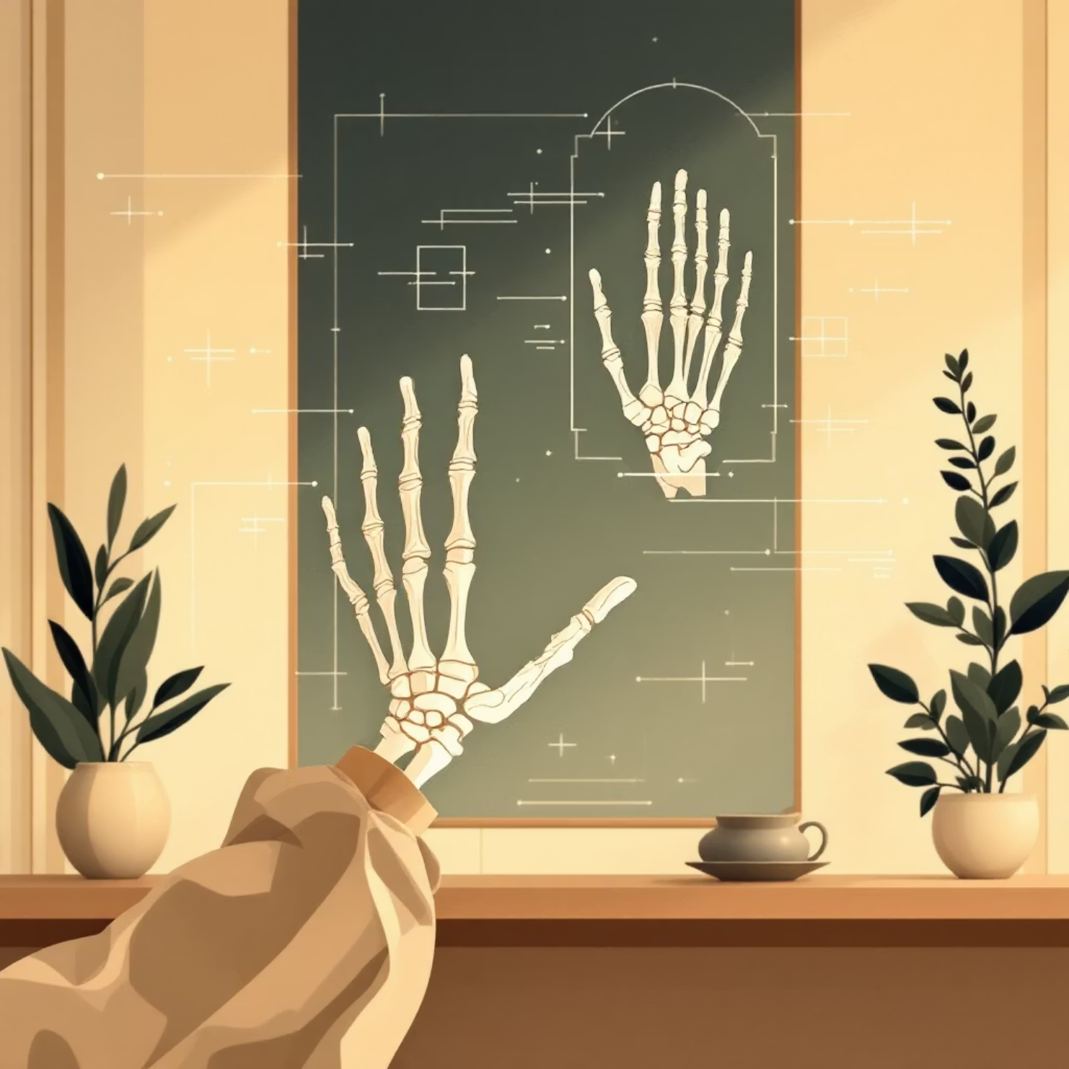
Perception: Hand Gesture Recognition
Our perception system focuses on real-time hand gesture recognition,
allowing the PiCar-X to interpret human commands visually.
Computer Vision Pipeline
Utilizing advanced computer vision techniques to detect and classify specific hand gestures.
Camera feed processing
Feature extraction (e.g., hand pose, finger orientation)
Machine learning model for classification

Slide 10
Challenges
Hardware Issues
Perception Challenges
Ultrasonic sensor calibration and accuracy
Lighting conditions affecting OpenCV accuracy
Motor jitter and inconsistent movement
Hand gesture recognition in varied environments
Power management and voltage stability
Real-time processing performance optimization
Software Bugs
System Integration & Safety
Python import and package dependency errors
Ensuring reliable obstacle detection
Robot stopping reliably when obstacles detected
Latency management across multiple pipelines

Slide 11
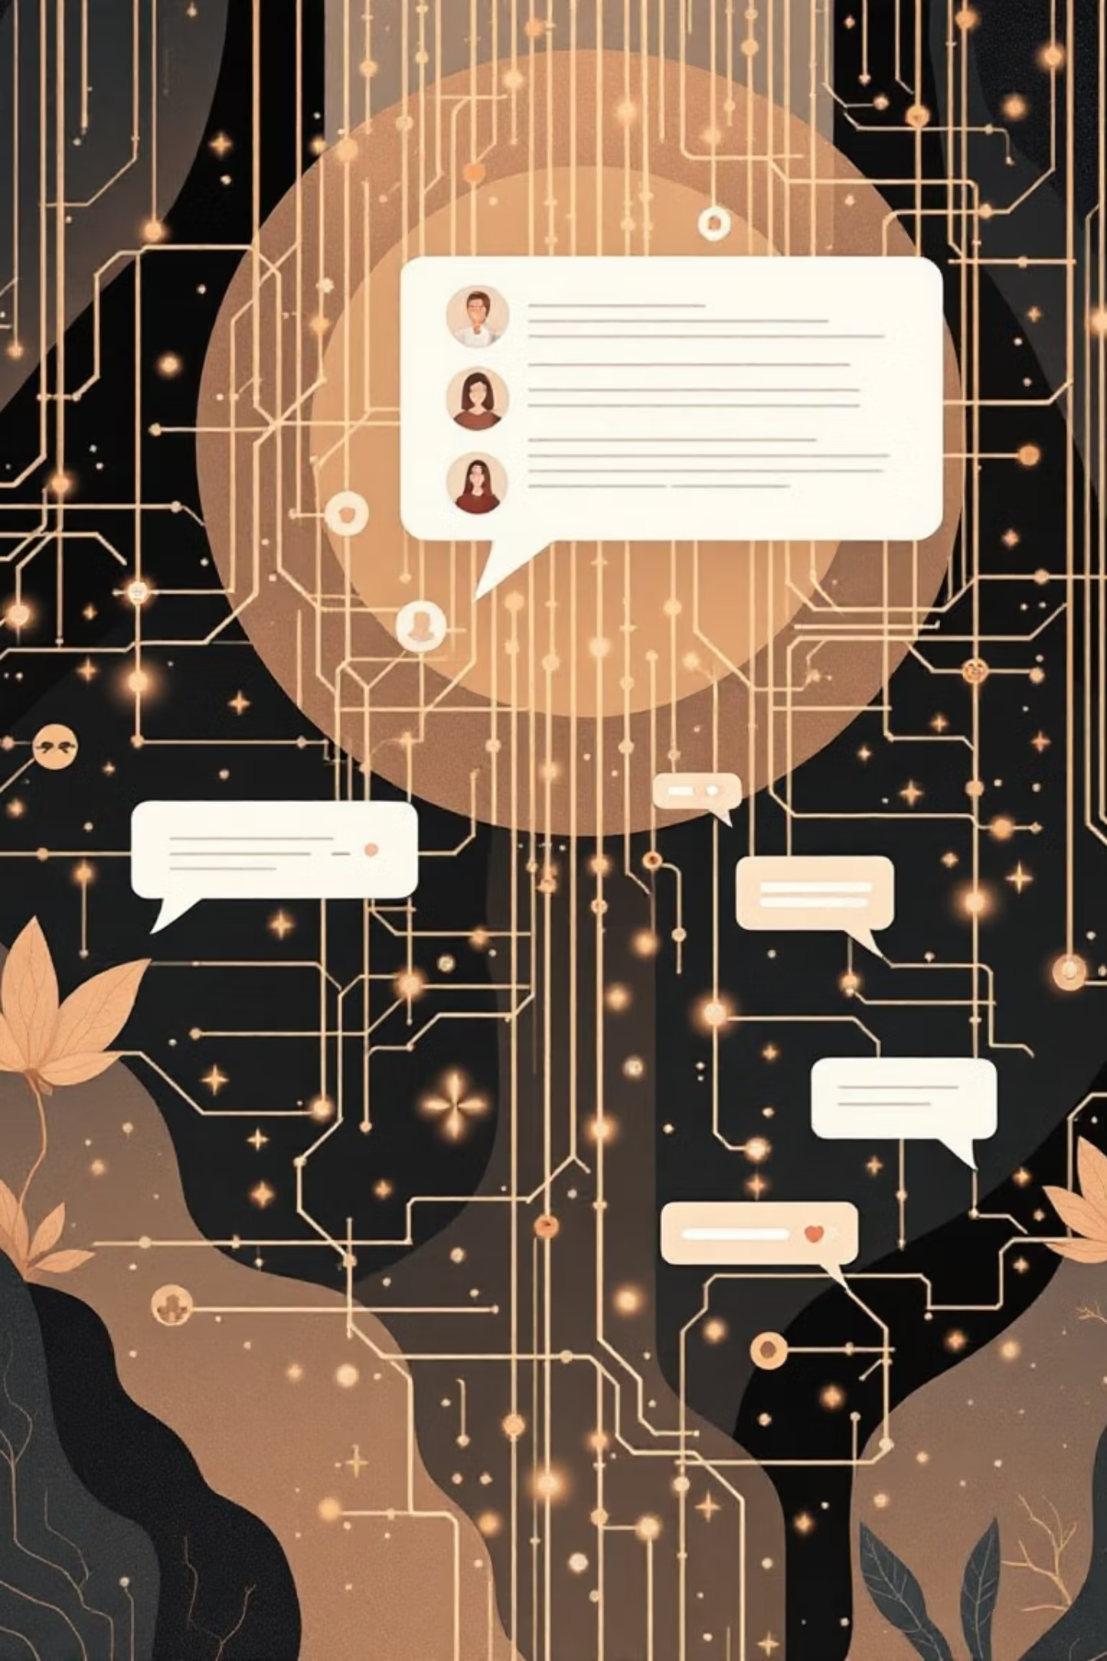
Decision Making: Integrating ChatGPT
ChatGPT provides a layer of intelligent decision-making, enabling the robot to understand complex instructions and engage in dynamic scenarios.
Natural Language Understanding
Contextual Awareness
Maintaining conversational context to respond intelligently to follow-up questions or commands.
Translating spoken or typed commands

Slide 12
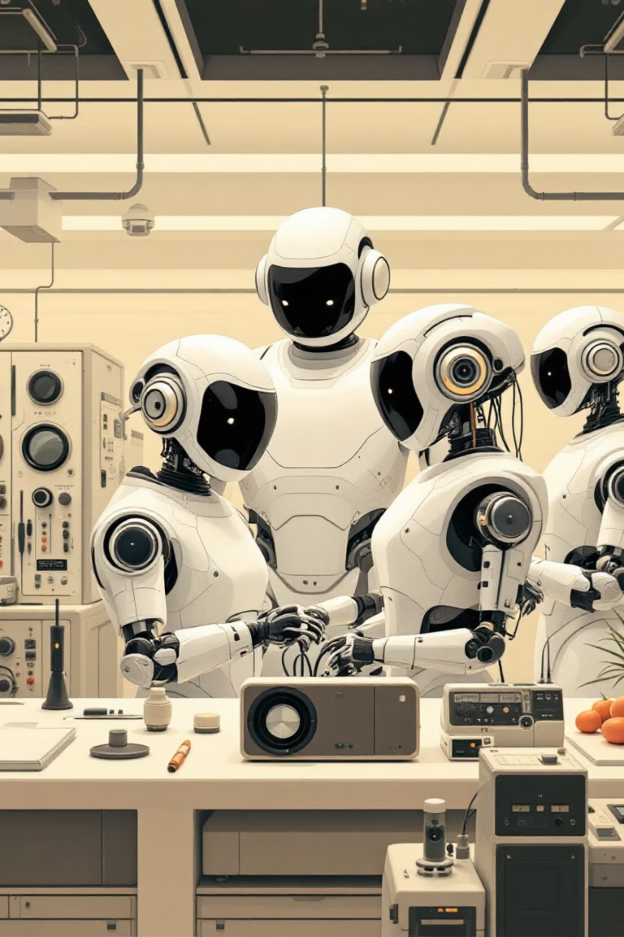
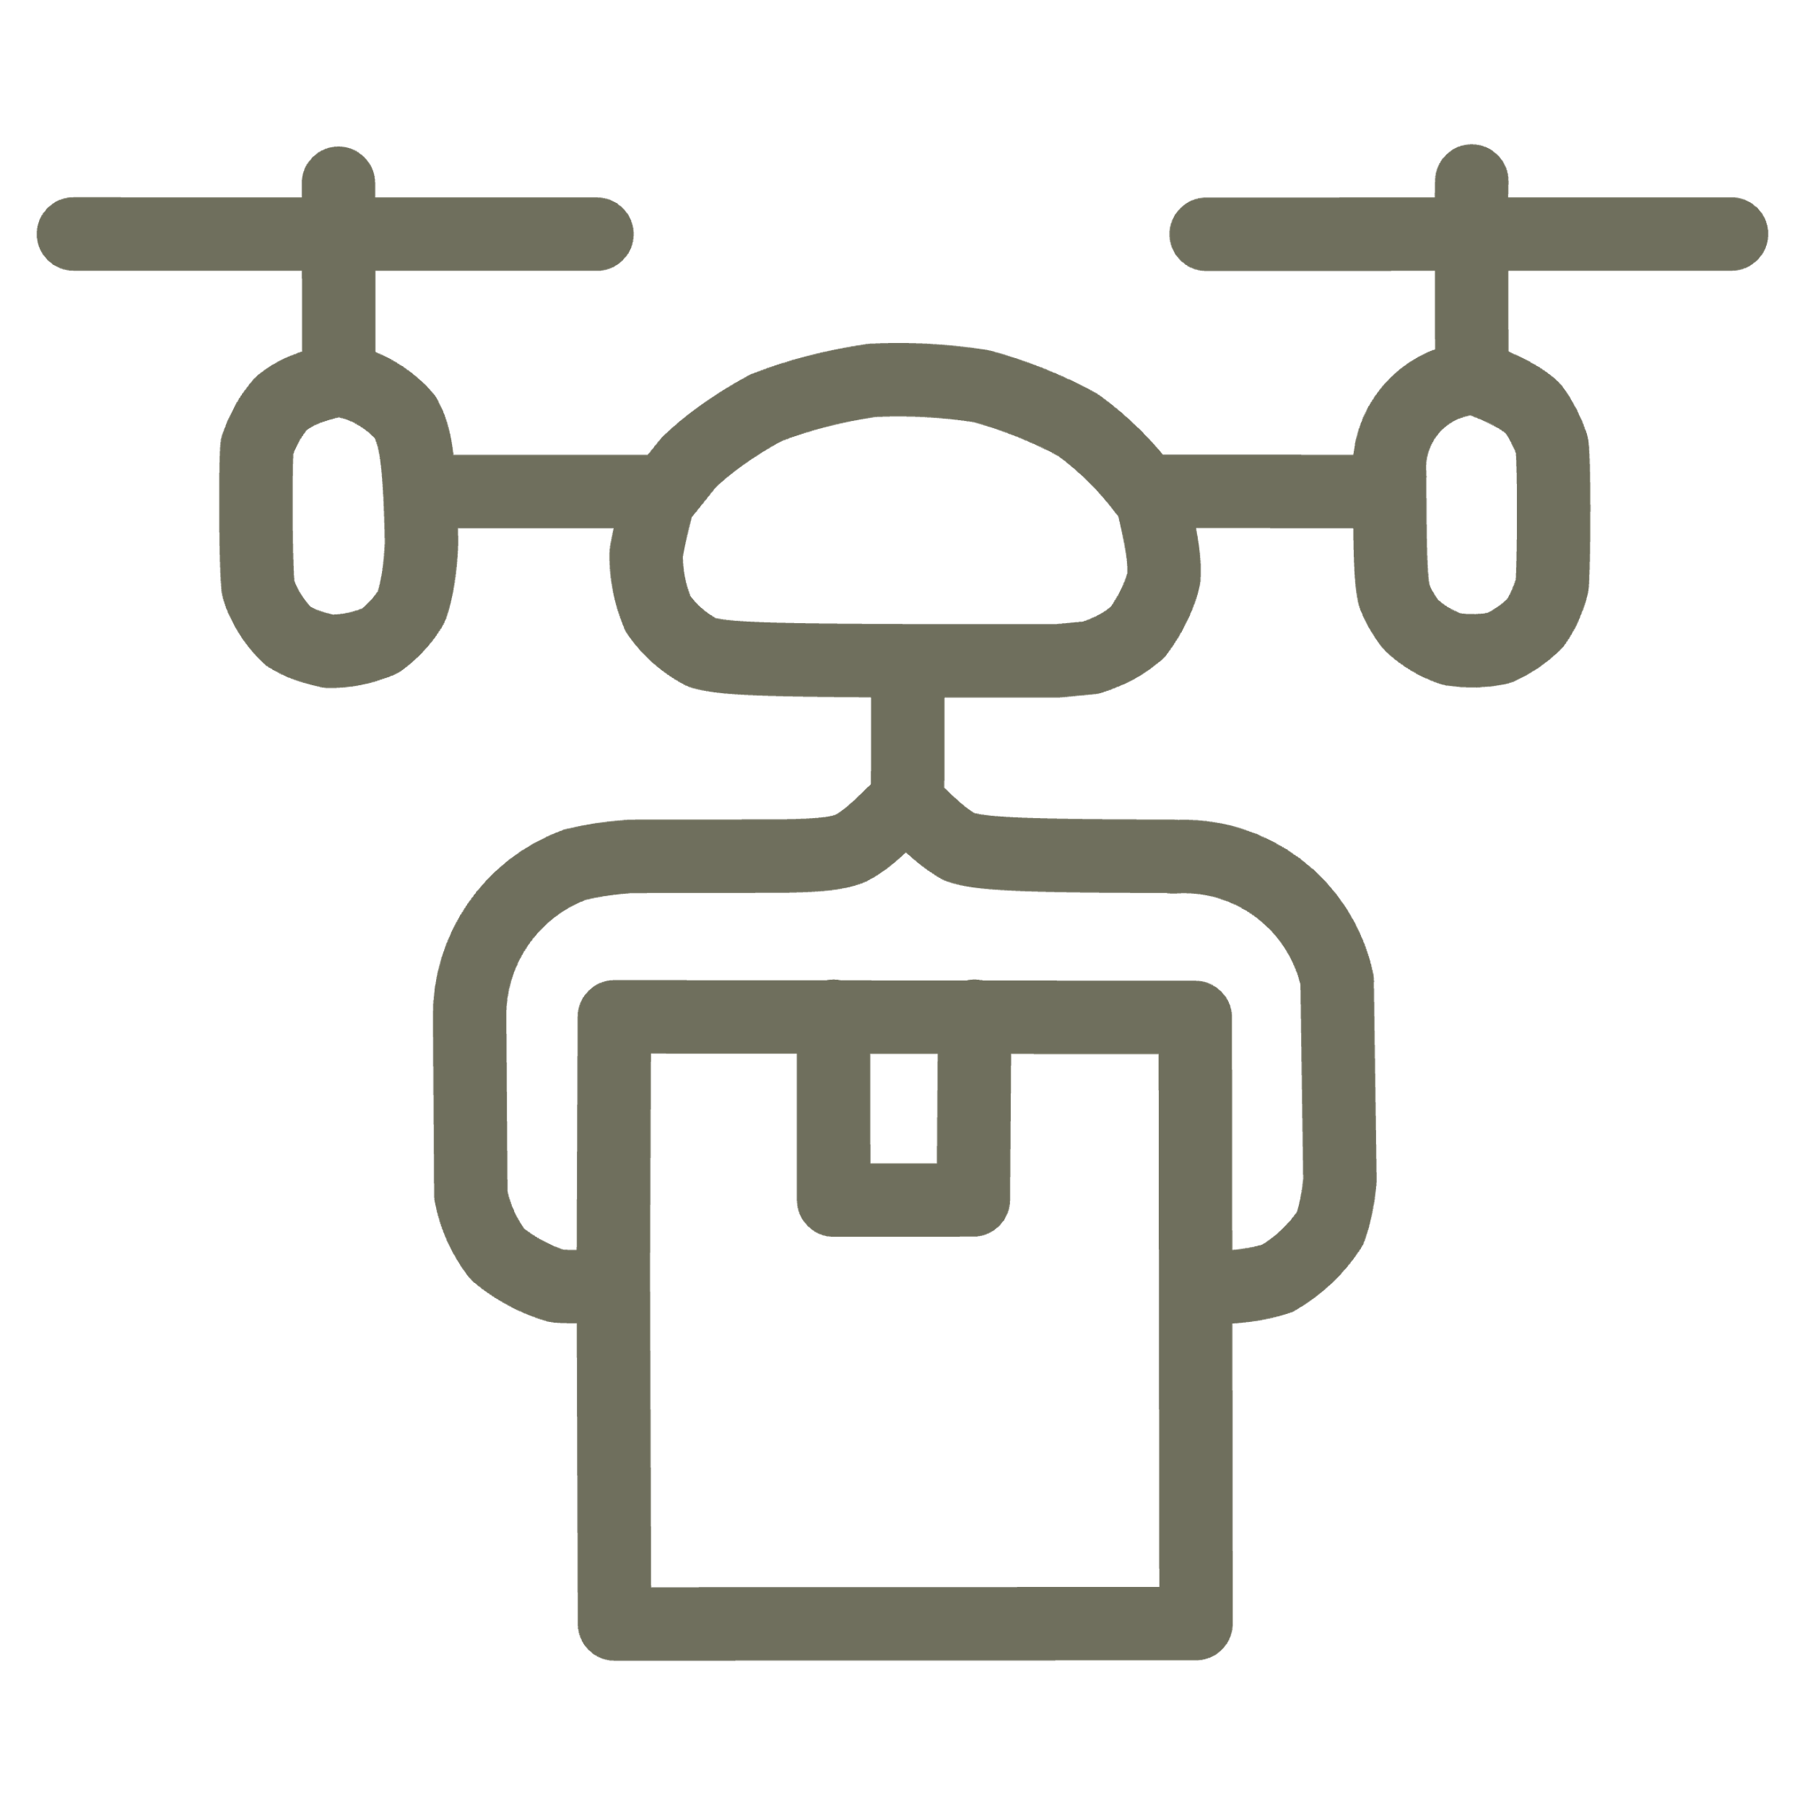

Future Directions: Expanding Capabilities
Our project lays a strong foundation for future enhancements, pushing the boundaries of AI-driven robotics on compact platforms.
Swarm Robotics
Reinforcement Learning
Coordination between multiple PiCar-X units for complex tasks.
Enabling the robot to learn optimal behaviors through trial and error.

Slide 13
Code Snippets
FOR CHAT GPT INTEGRATION
Python -m venv –system-site-pakcages my_venv
Cd my_venv
Source bin/activate
pip3 install openai
pip3 install openai-whisper
pip3 install SpeechRecognition
pip3 install -U sox
sudo apt install python3-pyaudio
sudo apt install sox
cd ~/picar-x/gpt_examples/
nano ~/picar-x/gpt_examples/
sudo ~/my_venv/bin/python3 gpt__car.py--keyboard
sudo /home/user06/picar-x/example/my_venv/bin/python3 gpt_car.py

Slide 14
Code Snippets
FOR HAND GESTURE DRIVEN RESPONSES
mkdir -p perception
nano perception/gesture_detector.py
nano perception/test_gesture
mkdir -p control
nano control/mode_manager.py
nano run_robot.py

